Slide 1
Lecture 15
Urban Hierarchy and Division of Labor in and Across Cities
15.2 Professional and Business Hierarchies and the Productivity of Cities
IUS Ch 5
©Luís M. A. Bettencourt 2023
Notes:
This module could have been presented before, as it corresponds to Ch 5 in the book. But in this sequence it is precursor to the problem of economic growth, which will be the subject of Lecture 16.

Slide 2
Observe the accommodation of most day laborers in a civilized and thriving country, and you will perceive that the number of people of whose industry a part, though but a small part, has been employed in procuring him this accommodation, exceeds all computation. […]
if we examine, all these things, and consider what a variety of labour is employed about each of them, we shall be sensible that without the assistance and co-operation of many thousands, the very meanest person in a civilized country could not be provided
Adam Smith (wealth of nations, ch 2)
Notes:
Before modern times, classical economists thought that the main cause of wealth (economic growth there fore, of a kind) was the division of labor. It is arguably the most important phenomenon in Economics, and it follows from related phenomena in Biology as Jane Jacobs or Emile Durkheim had pointed out. Where does the division of labor actually happen? Adam Smith gave you the answer already, in places where people live together…

Slide 3
Professions in the USA
credit: bls.gov
https://www.bls.gov/news.release/archives/ocwage_05172011.pdf
Notes:
But it is still a fascinating phenomenon. Here are some data on the most common professions in the US, and what they paid in 2010. Indeed, nation of salespeople.

Slide 4
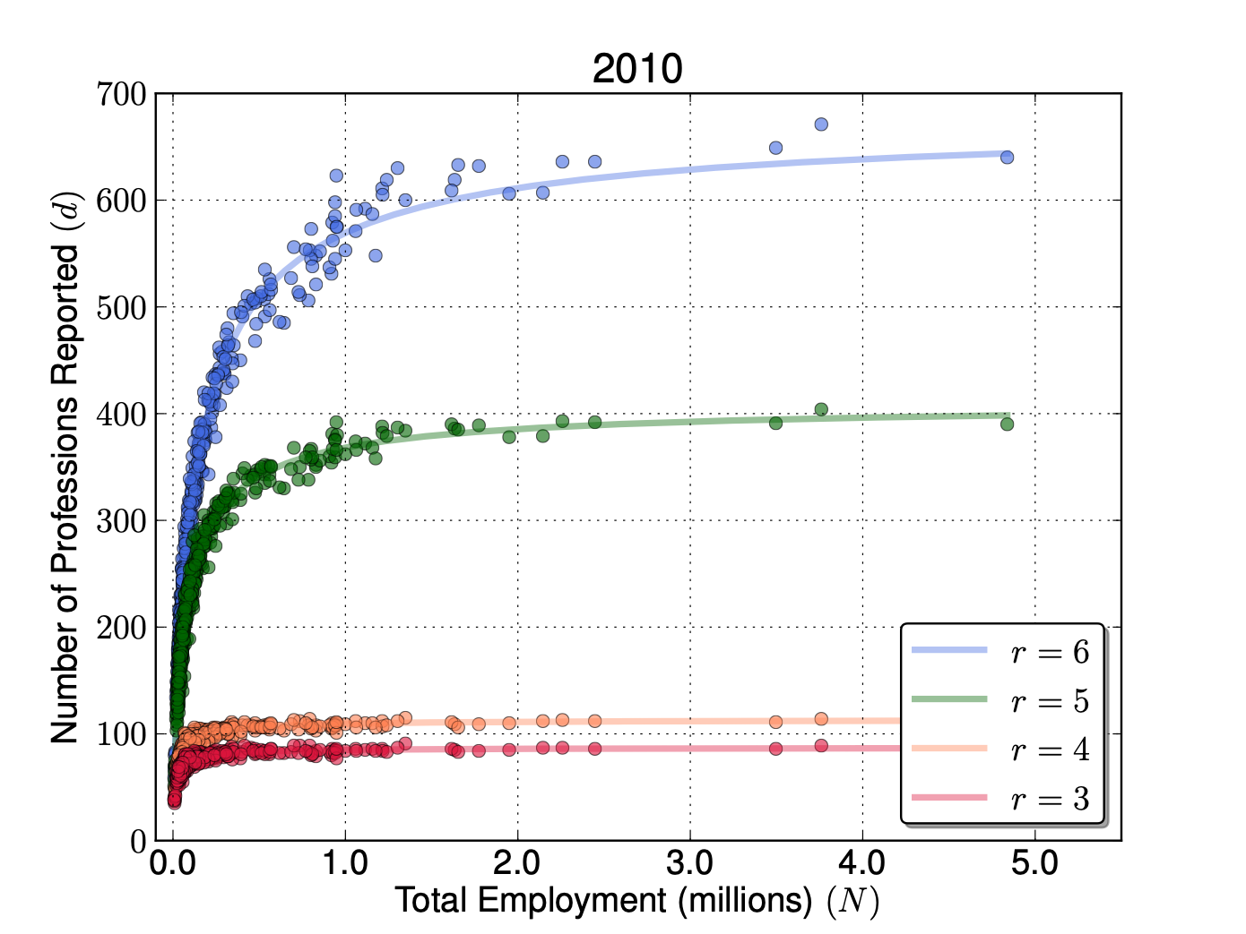

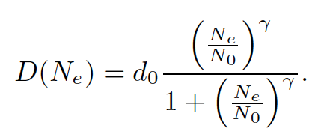
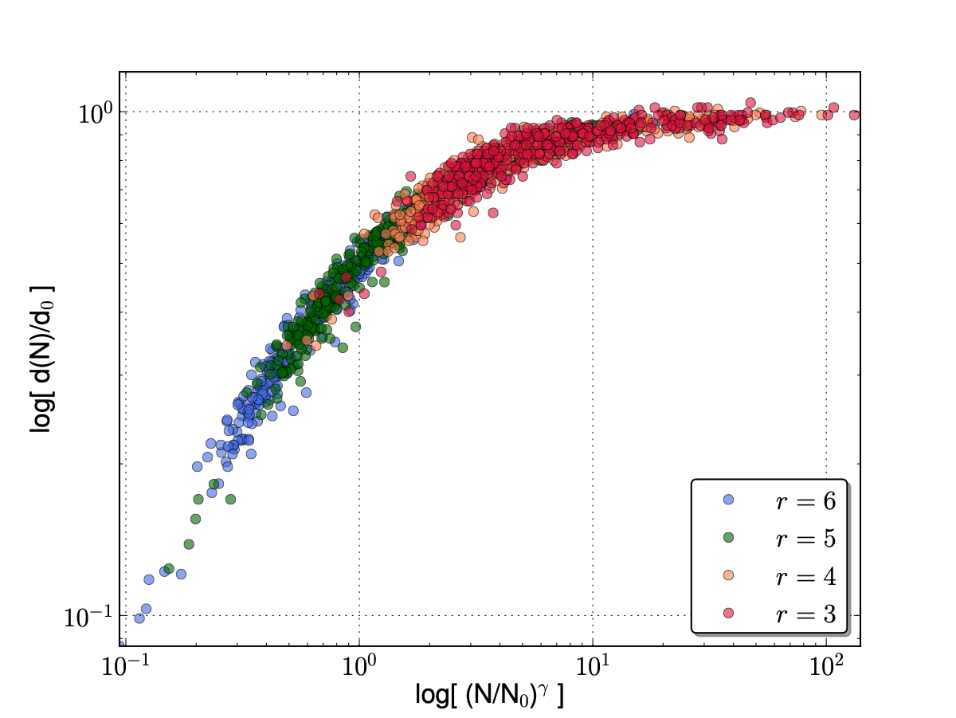
Professional Diversity and Classification Resolution
Occupations in US
Metropolitan Statistical Areas
resolution
A good fit at all resolutions:
occupation richness
$$γ=1-δ≃\frac{5}{6}$$
https://www.nature.com/articles/srep05393
Notes:
But how does this get expressed in Cities. Recall that in Central Place Theory there was an expectation of functional hierarchy, and that larger cities had all the functions of smaller places plus a few. We can see this explicitly and quantify the pattern by plotting the number of professions versus the number of people employed as here. Data come with professions specified at different resolutions r. In schemes with higher r there are more professions as categories get subdivided. The data are well fit by the function on the left, as shown. Also, the number of professions seems to saturate (stop growing) but this is because the resolution is too small.

Slide 5
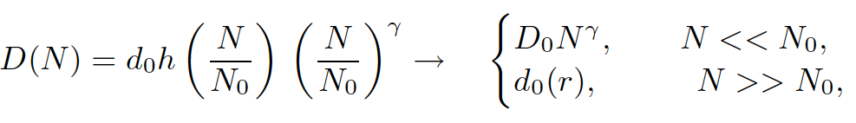
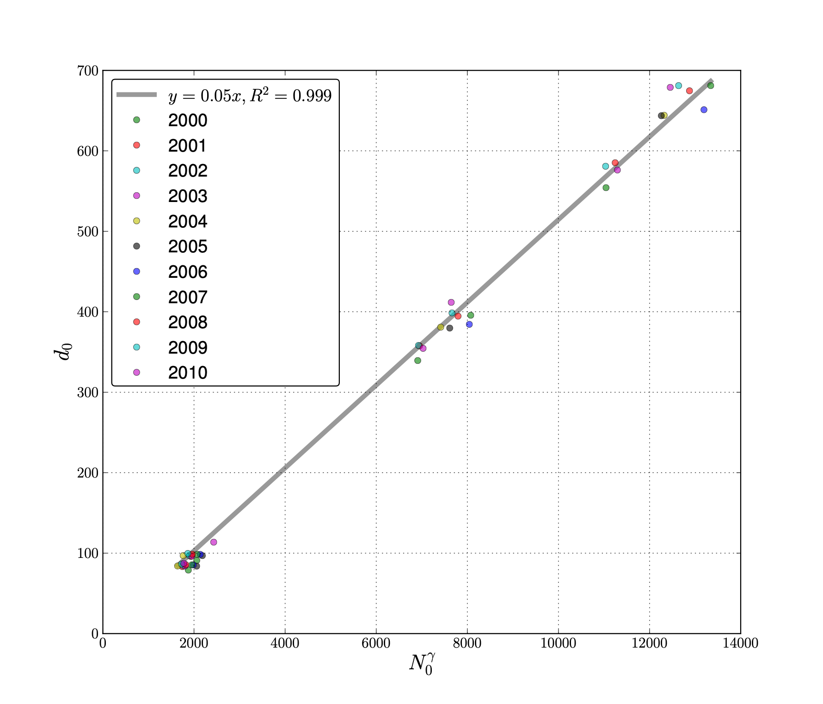
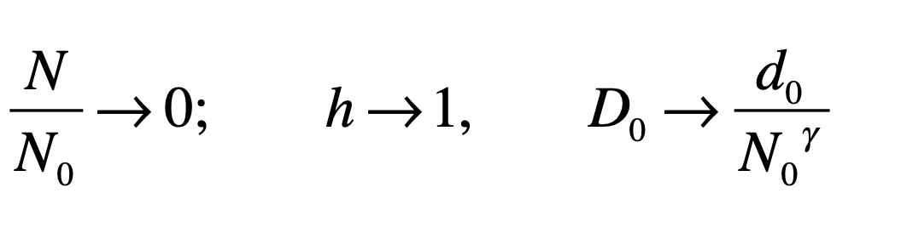
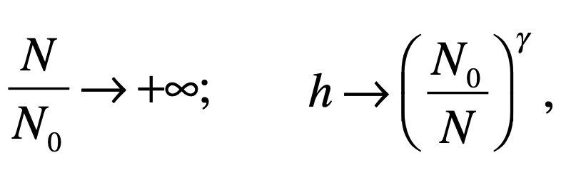
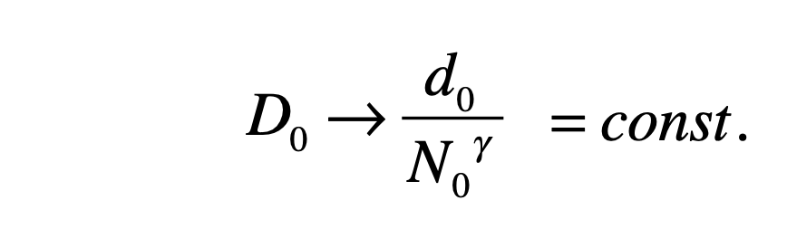

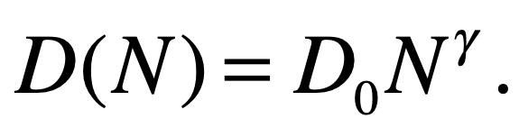
Inferring actual diversity D(N):
In the limit:
In the limit:
A scaling limit exists iff:
with
https://www.nature.com/articles/srep05393
Notes:
There is a trick that allows you to take a set of data at different resolutions and extrapolate it to infinite resolution (!). You can see the reasoning above, if there is a regime with no saturation, the total professions d_0 and characteristic saturating population N_0 need to increase in tandem in a specific way. We look at the data we have and can see that this is exactly what is going on !! This allows us to calculate D_0 and the power law dependence of the number of professions when there is no saturation.

Slide 6
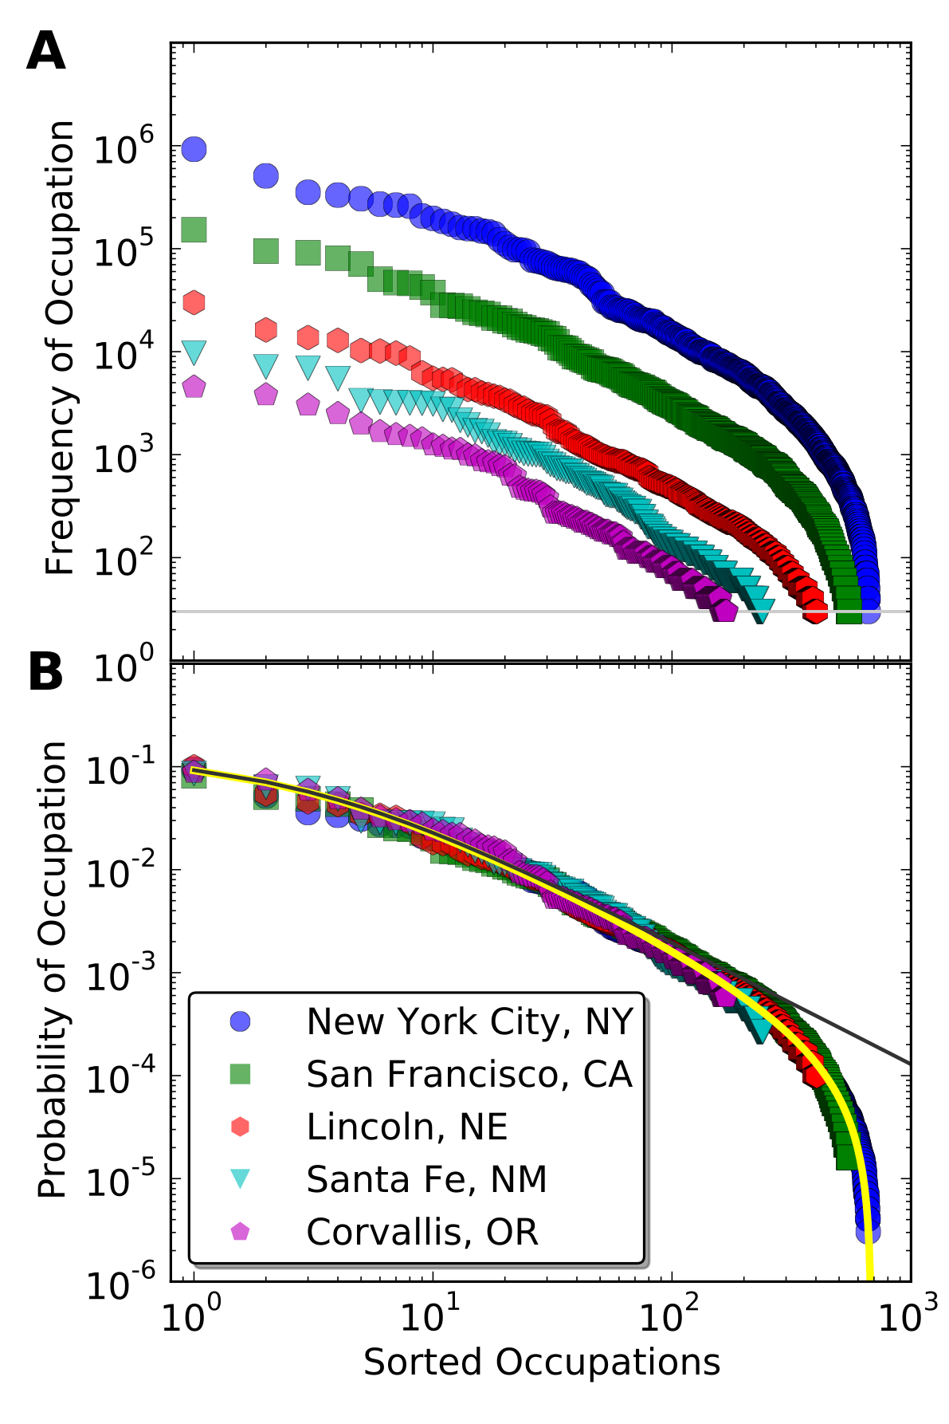
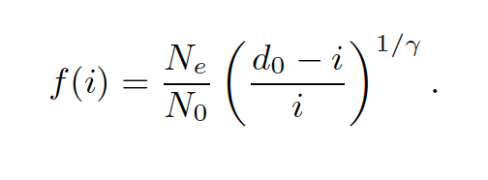
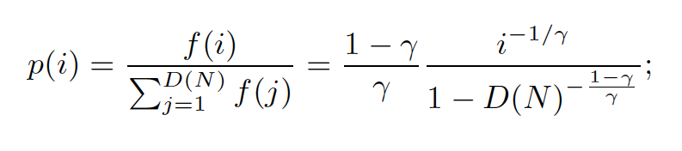
The rank size distribution of professions
From D(N), for all N, derive frequency distribution
Universality!
https://www.nature.com/articles/srep05393
Notes:
We can also find the rank distribution of professions in any city, which allows us to tell the relative proportion of professions in any city! Once we have this we can show that all cities follow the same distribution (universality), I.e. all cities are the same in terms of the division of labor ! It is just that larger cities are farther along that process.

Slide 7
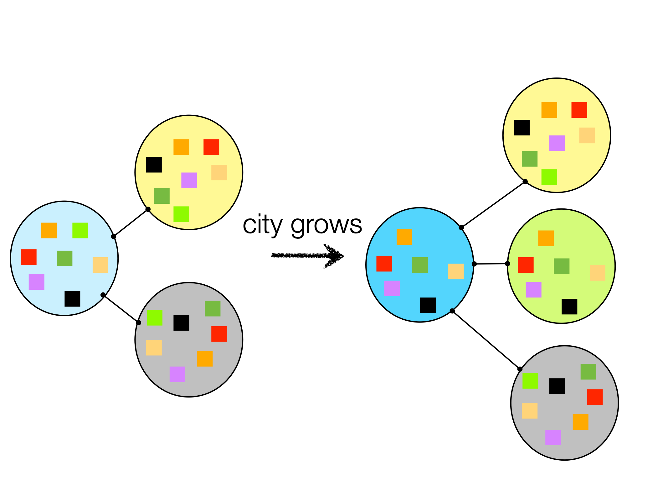
Professional Diversity and Urban Productivity
Specialization and Division of Labor
as sources of increases in urban productivity
$$D/N=D_{0}N^{-δ}$$
specialization
$$y=Y_{0}N^{δ}=GI(N)$$
interactions per capita
productivity
$$I(N)*\frac{D(N)}{N}=F$$
independent of city size
better quality, more segmented functions
In a larger city I get more different things from more different people,
to satisfy same needs
https://www.nature.com/articles/srep05393
Notes:
What is this process? and how is it related to the superlinear scaling relations for wealth creation (income) that we observed and derived earlier? As people have more interactions, they can obtain products and services from others, and themselves specialize (like the others). We observe that the D/N which are professions per capita decrease (specialization) precisely in the inverse way that productivity increases. There is therefore a conserved quantity, as the product independent of city size. This quantified the possibilities of specialization in terms of the number of external links and shows that the rate of increase in one is the same as the increase in the other.

Slide 8
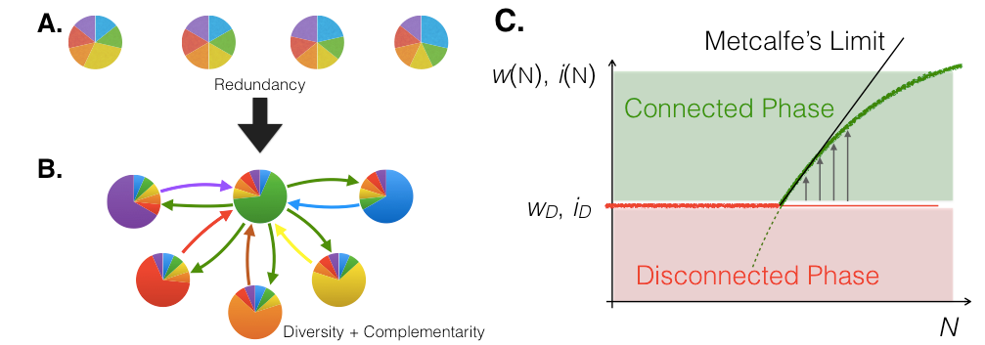
Information, Connectivity & Productivity Growth
Poor
Rich
Bettencourt 2014, IEEE
The role of technology in complex networks
https://ieeexplore.ieee.org/stamp/stamp.jsp?arnumber=6957033
Notes:
Let’s push on this point, inspired by our findings but also on general observations, such as those by Adam Smith: At the extremes, societies that are rich and complex in terms of their capabilities are also urban (and interconnected). At the other extreme, societies where everyone is self-sufficient are poor and redundant in that everyone knowns more or less about the same things, such as farming, hunting and gathering. To go from a disconnected to a connected regime, we need to create the conditions for close connectivity an the division (and interdependence) of labor: That’s cities.

Slide 9
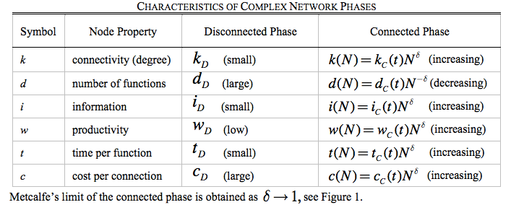
Interconnected human societies
contain more information at higher connectivity costs
https://ieeexplore.ieee.org/stamp/stamp.jsp?arnumber=6957033
Notes:
In this paper, I elaborated on what quantities are at play in this transition and how they interact with each other. The novel ones here are information (learning), which happens - among other ways - by doing a thing more often. So not only there is the division of labor but there is new knowledge. We may say that the brain surgeon is latent in the common doctor, or the opera singer in the entertainer, but there is new knowledge that is created by specialization in more specific tasks and intensification (more time spent) doing them. This is a physical+social theory of economic development, and it has urban environments at its heart.

Slide 10
In a real sense all life is inter-related.
All people are caught in an inescapable network of mutuality, tied in a single garment of destiny.
Whatever affects one directly, affects all indirectly.
I can never be what I ought to be until you are what you ought to be, and you can never be what you ought to be until I am what I ought to be…
This is the inter-related structure of reality.
- Martin Luther King Jr, Letter from Birmingham Jail.
Notes:
And to push it even further, you can take the same idea to mortal philosophy and ethics. In this sense, people burdened by basic tasks and oppression cannot be fully themselves. That should be easier in (good !!) cities, at least for more people.

Slide 11
Business Diversity
Notes:
Let’s now also spend a little time with businesses, not just professions. There is some overlap, of course but typically businesses are (hierarchical) arrangements of professions and it turns out that their statistics behave differently.

Slide 12
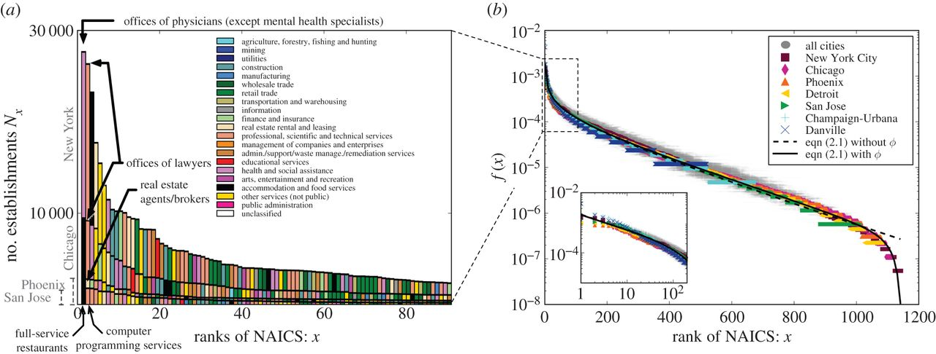
Establishment Types
Youn et al 2016
https://royalsocietypublishing.org/doi/10.1098/rsif.2015.0937
Notes:
Here is a similar plot about the frequency of different businesses in US MSAs.

Slide 13
Rank Establishment Types
Youn et al 2016
https://royalsocietypublishing.org/doi/10.1098/rsif.2015.0937
Notes:
And here is a similar (but different in form) rank size distribution.

Slide 14
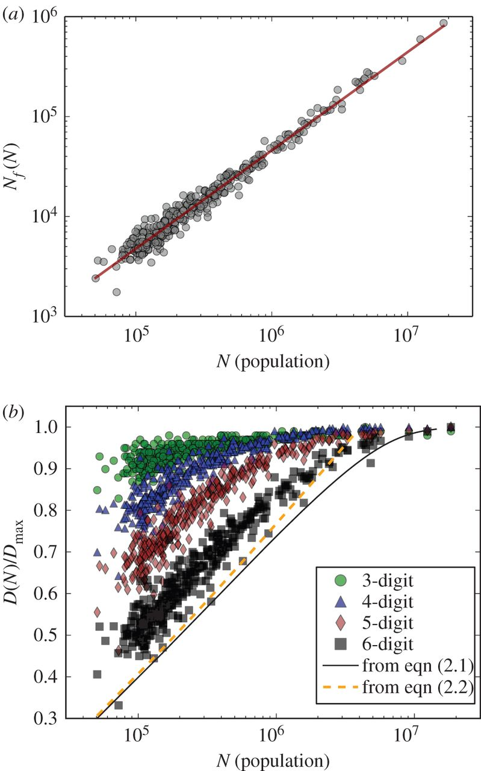
number of establishments
# establishments types
Youn et al 2016
https://royalsocietypublishing.org/doi/10.1098/rsif.2015.0937
Notes:
Number of establishments (places of employment, not types) are linear on population, but the number of unique types are approximately logarithmic, also with some saturation.

Slide 15
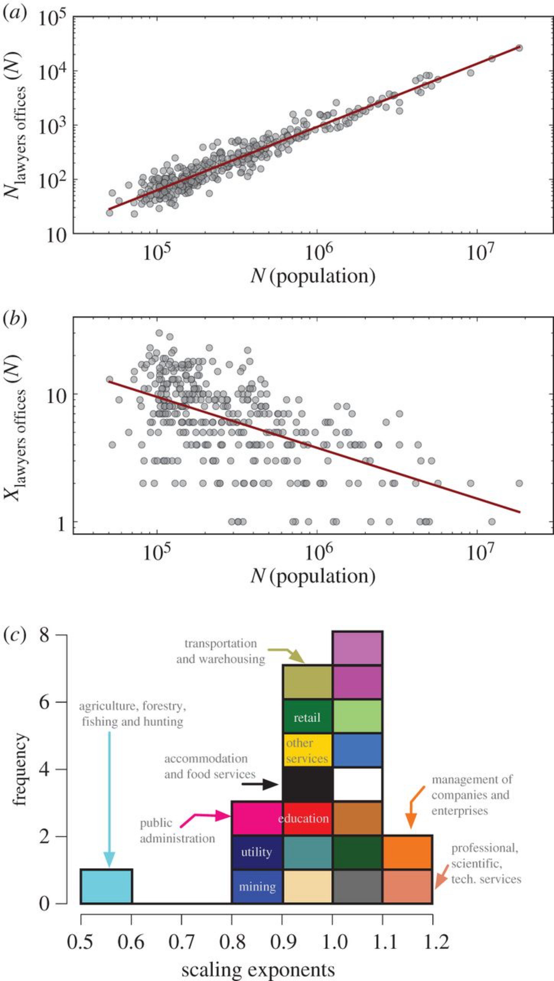
Scale each business type on population
Number of Lawyers Offices
Rank of Lawyers Offices
Youn et al 2016
https://royalsocietypublishing.org/doi/10.1098/rsif.2015.0937
Notes:
We can then also look at the scaling of different businesses, such as lawyers offices, which of course “plague” great cities and became (in the US) almost the most common business (rank 1).

Slide 16
Youn et al 2016
https://royalsocietypublishing.org/doi/10.1098/rsif.2015.0937
Notes:
Here is how different sectors scale, some becoming more prevalent with city size (right), and others less (left). Just as expected, informational activities increase in frequency in larger cities and primary activities decrease.

Slide 17
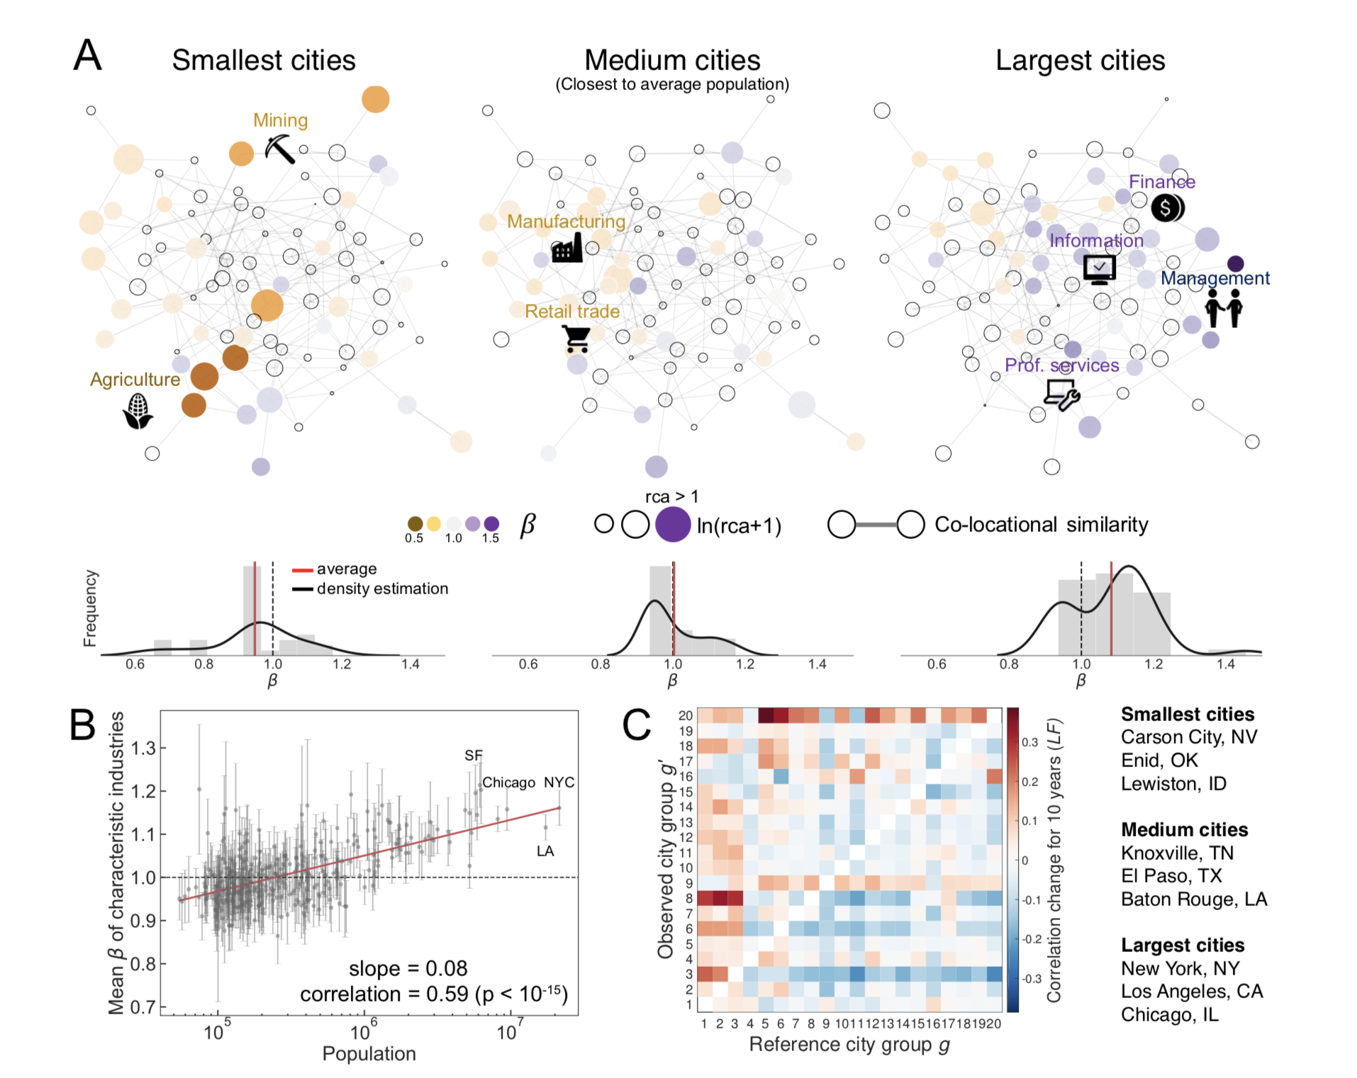
Recapitulation of Business Sectors
Hong et al 2018
https://www.science.org/doi/10.1126/sciadv.aba4934
Notes:
Hong and collaborators analyzed in more detail how these spaces of types are populated as cities grow.

Slide 18
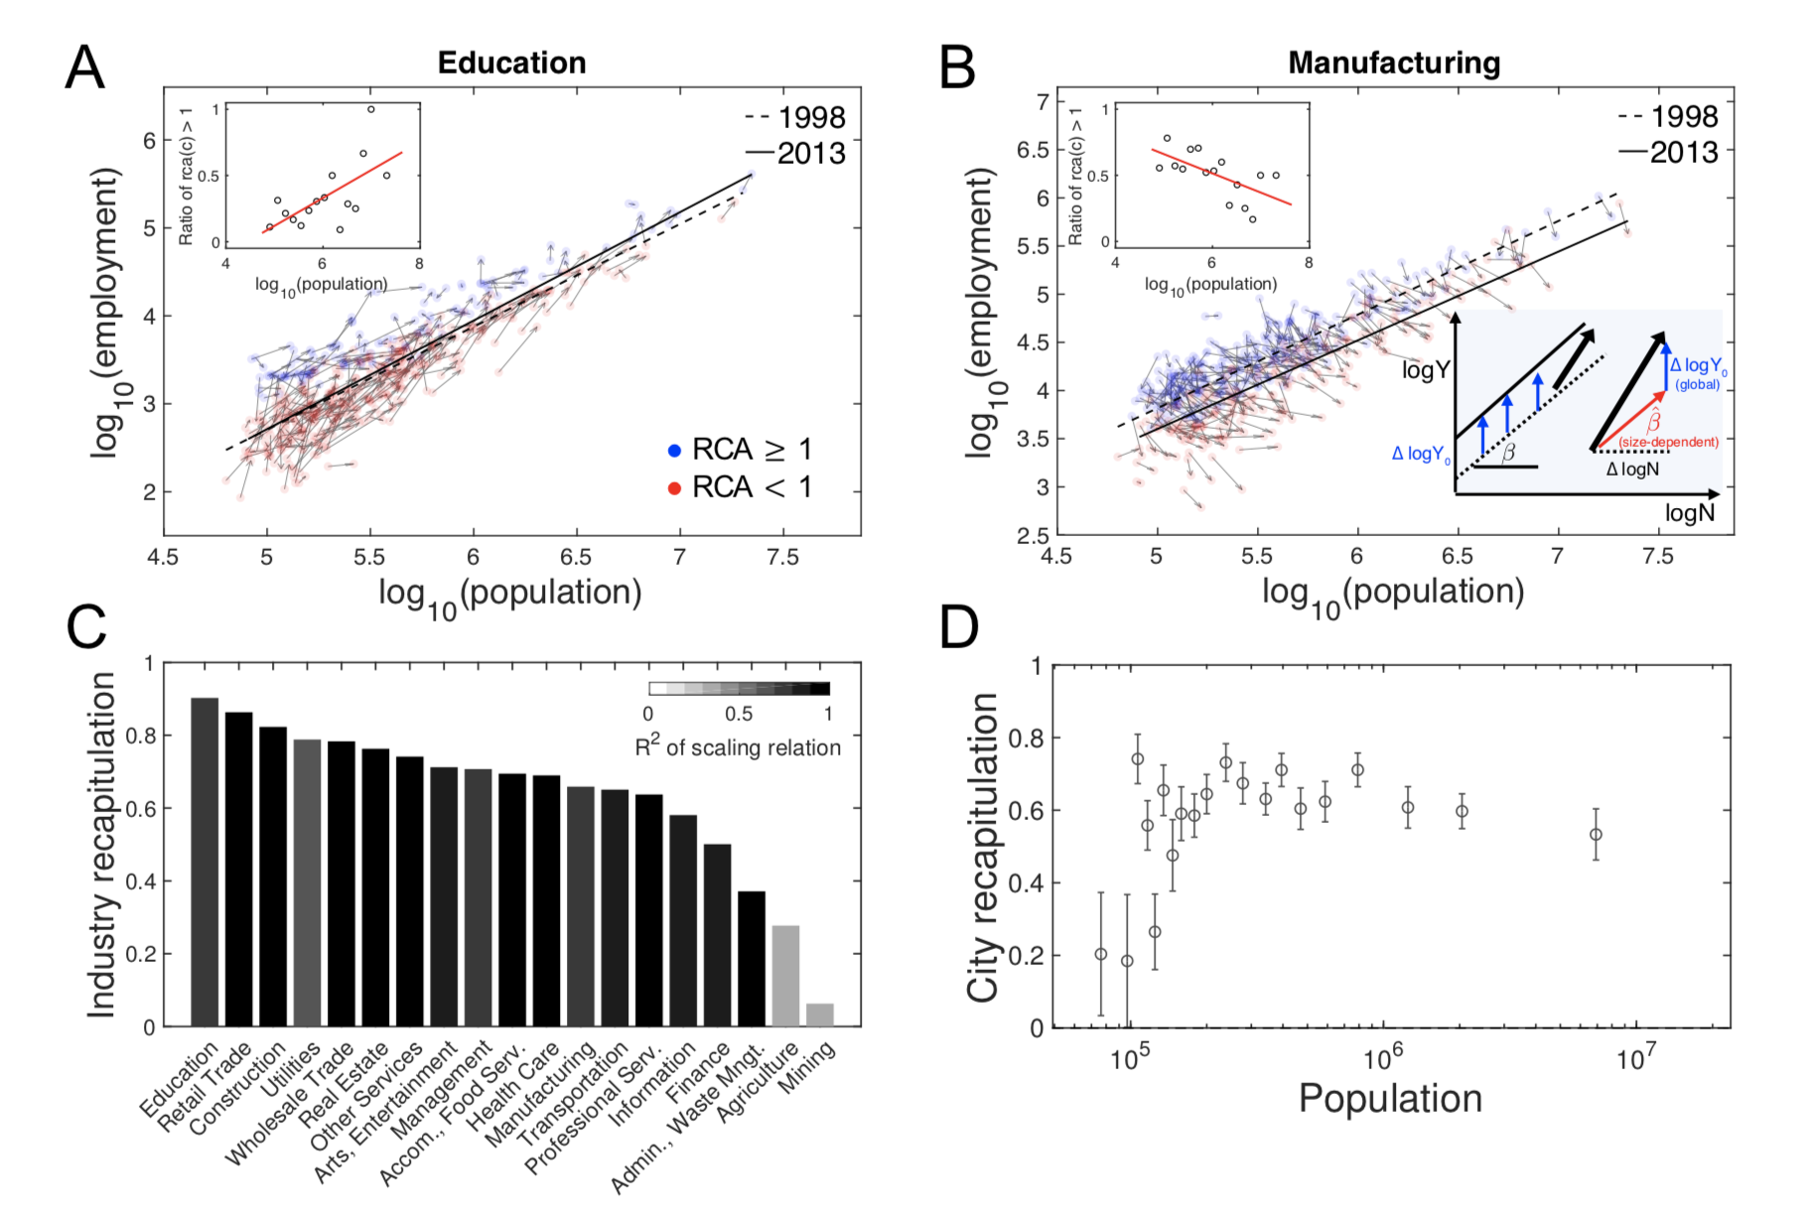
Recapitulation of Business Sectors
Hong et al 2018
https://www.science.org/doi/10.1126/sciadv.aba4934
Notes:
And argued that the composition is to a large extent recapitulated so that a city that starts smaller ends up with the same composition of a city that is larger but grows more slowly. Some differences will of course emerge as new sectors come in…

Slide 19
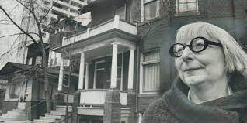
Frank Lennon/Getty Images
I’m convinced that economic life is ruled by processes and principles we didn’t invent and can’t transcend,
whether we like that or not,
and that the more we learn about these processes and the better we respect them, the better our economies will get along.
- Jane Jacobs, Cities and the Wealth of Nations, 1984
generalizations differentiations
“fixation”
“mutations”, recombinations: innovations
functional hierarchy
selection and spread
complementarities + interdependence
Notes:
So, as Jane tells us here, the division of labor, specialization, interdependence are not exclusive to human societies, they occur also in ecosystems. This points again for a view of cities - and the processes they embed - as a natural phenomenon that is both unique in speed and scope, but general in terms of its origins and logic. I agree with her.

Slide 20
Functional Diversity is related to Complementarities
Division of labor, knowledge, interdependence
(second reason (Marshall) for agglomeration economies)
This creates an “ecology” of functions in cities that is quite predictable, with small cities disproportionally dedicated to primary sectors and large cities to informational activities
Interactions, degree of specialization and economic productivity are facets of transformation predicted by urban scaling
Notes:
The division of labor and the wealth of nations does not happen in vacuum or in abstracted markets, it happens in places where millions of people can interact continuously to become interdependent. That is in cities.

